Slide 1



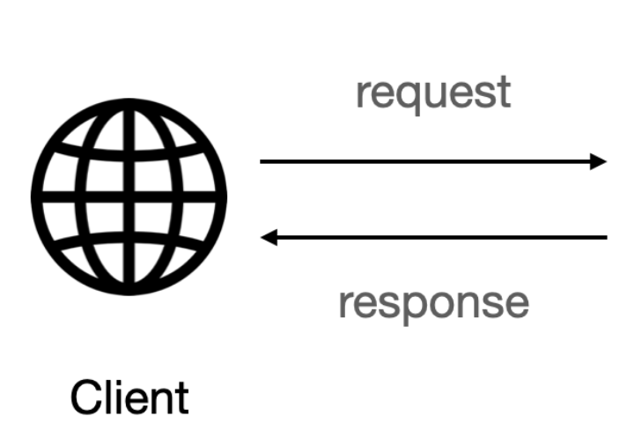




HTML,CSS Template to
Selection Metric :
Date: Start Date : END Date
Time Frame :6,12,24
GET response to request for the Forcast
Serves the GET Request
Serves the POST resquet
Serves the PUT resquet
POST /PUT response with the Forcast
Serves the DELETE resquet
HTML,CSS Template which display the Forcast
POST ==> When we need a new forcast
PUT ==> When we need to update the Existing forcast

